Slide 1

Two Phase Simplex Algorithm
Created by Group 10 - V-am
Members
* Alexander Kruger - 605298
* Marvin Netshirando - 605733
* Tawanda Marimo - 601434

Slide 2

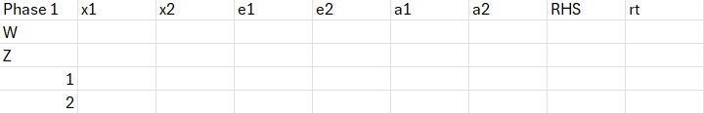

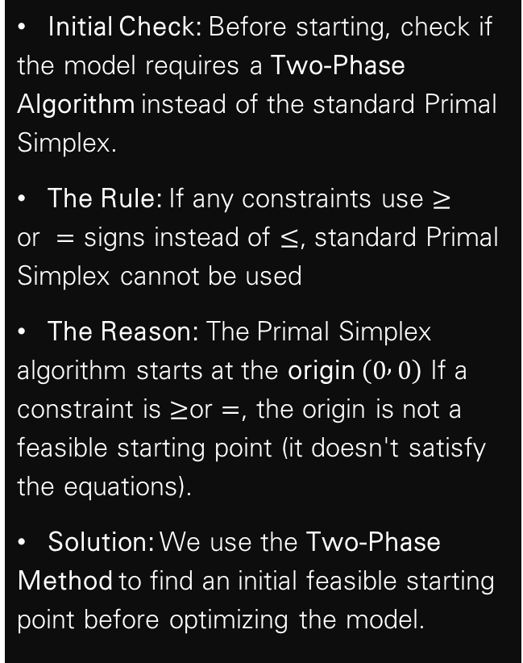
When is the Two-Phase Simplex Necessary?
Initial Check: Before starting, check if the model requires a Two-Phase Algorithm instead of the standard Primal Simplex.
The Rule: If any constraints use $≥$ or $=$ signs instead of $≤$, standard Primal Simplex cannot be used
The Reason: The Primal Simplex algorithm starts at the origin $\left(0 , 0\right)$ If a constraint is $≥$or $=$, the origin is not a feasible starting point (it doesn't satisfy the equations).
Solution: We use the Two-Phase Method to find an initial feasible starting point before optimizing the model.

Slide 3


Rewrite all inequalities as equalities
#note I = index of current constraint
For $=$ constraints: Add an artificial variable($a_{i}).$
For $≤$constraints: Add a slack variable ($s_{i}$).
For $≥$constraints: Subtract an excess variable ($e_{i}$) and add an artificial variable ($a_{i}).$

Slide 4


Rewrite Objective function ($Z$)
+
Add new Objective function (W)
Prepare the $Z$row:
Move all variable terms to the same side as $Z$and set the equation to zero. Ensure the coefficient of $Z$ is positive.
Define the $W$function:
In Phase 1, we aim to eliminate artificial variables. Set $W$equal to the sum of all artificial variables: $W=a_{1}+a_{2}+…$
Isolate Artificial Variables:
From your constraint equations, rewrite each one to make the artificial variable ($a_{i})$ the subject.
Substitute into $W$ :
Substitute these expressions into your $W$equation. This ensures the $W$-row in your starting tableau is mathematically consistent.
Prepare the $w$row:
Move all variable terms to the same side as $W$ and set the equation to a constant . Ensure the coefficient of $W$ is positive.

Slide 5


Setup 1st Tableau
(Phase 1 start)
1 - Row Setup: Create two Objective Rows ($W$and $Z$) followed by one row for each constraint.
2 - Column Setup: Create one column for every variable ($x_{i},s_{i},e_{i},a_{i}$), one for the RHS, and one for the Ratio ($θ$).
3 - Data Entry: Populate the table with the coefficients from your equations and the RHS values.
4 - Initialization Note: Before the first optimality check, ensure the $W$-row’s $a_{i}$ has coefficients of 0 . If this is not the case you skipped a step in the last section.
6 - Check Feasibility : If solution is optimal, check on the RHS column on the $W$-row, if its 0. If so the solution is possible and we move onto phase 2. Otherwise its infeasible
5 - Check Optimality : If the $W$-row’s variables have no negative coefficients we check feasibility , otherwise we pivot .

Slide 6


Pivoting explanation
(Phase 1 pivot)
1 - Pivot Column: Identify the largest negative coefficient in the $W$-row.
2 - Ratio Test: For each constraint row, divide the RHS by the value in the Pivot Column.
3 - Pivot Row: Select the row with the lowest positive ratio. The intersection point is your Pivot Element.
4 - Update Pivot Row: In the new table, divide every cell in the old pivot row by the Pivot Element.
5 -- Update All Other Cells: Use the following formula:
New Cell =Old Cell − (Pivot Column Value * Updated Pivot Row Value)
7 - Check Feasibility : If solution is optimal, check on the RHS column on the $W$-row, if its 0. If so the solution is possible and we move onto phase 2 and we can delete the $W$-row and all artificial variables . Otherwise its infeasible and we can stop here .
Pivoting is simply the movement to an extreme corner point of the feasible solution, in phase 1 this is done to find the feasible area since we don’t start in it, like the primal simplex algorithm
6 - Check Optimality : If the new $W$-row’s variables have no negative coefficients we check feasibility , otherwise we pivot again .

Slide 7

Pivoting explanation
(Phase 2 pivot)
1 - Pivot Column: Identify the largest [negative if max-, positive if min- problem] coefficient in the $Z$-row.
2 - Ratio Test: For each constraint row, divide the RHS by the value in the Pivot Column.
3 - Pivot Row: Select the row with the lowest positive ratio. The intersection point is your Pivot Element.
4 - Update Pivot Row: In the new table, divide every cell in the old pivot row by the Pivot Element.
5 -- Update All Other Cells: Use the following formula:
New Cell =Old Cell − (Pivot Column Value * Updated Pivot Row Value)
6 - Check Optimality : If the new $Z$-row s variables have no [negative if max-, positive if min- problem] coefficients we have found the optimal solution , otherwise we pivot again .

Slide 8
Interpreting results
(Phase 2 Results)
Currently all our x variables are basic variables, meaning it consists only of 0’s and a single 1 in the table , on the 1’s position the corresponding RHS shows its value. The RHS of the objective function shows the optimal solution. If any of the slack or excess variables are also basic it means they aren’t binding constraints as they don’t use up all the resources.

Slide 9
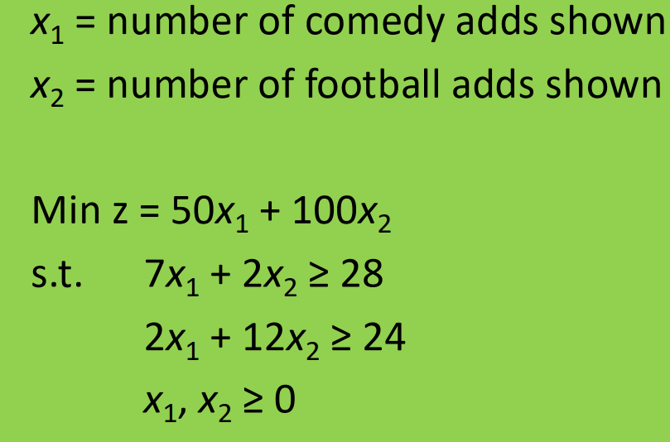
Two Phase Simplex Example

Slide 10


Canonical form
W + ${9x}_{1}+$ ${14x}_{2}$ - $e_{1}$ - $e_{2}$ = 52
Z - ${50x}_{1}$ - ${100x}_{2}$ = 0
$a_{1}$ = 28 - ${7x}_{1}−$ ${2x}_{2}$ + $e_{1}$
$a_{2}$ = 24 - ${2x}_{1}−$ ${12x}_{2}$ + $e_{1}$

Slide 11
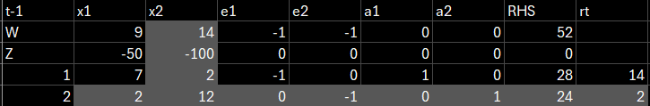
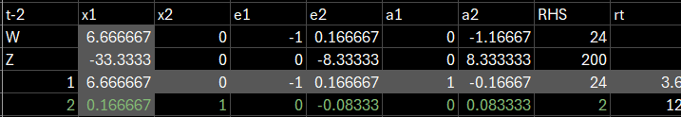

Tableau's

Slide 12
Conclusion
In conclusion the Two-Phase Simplex Algorithm is necessary when constraints use ≥ or = signs, because the origin is not a feasible starting point for standard Primal Simplex. In Phase 1, we rewrite all inequalities as equalities by adding slack, excess, and artificial variables. We then minimize the W function to drive all artificial variables out of the solution. If W equals zero at optimality, we have a feasible solution and can proceed. In Phase 2, we drop the W row and all artificial variables, then pivot on the Z row until we reach the optimal solution checking for the largest negative coefficient in a minimization problem. As shown in our worked example, minimizing Z = 50x₁ + 100x₂ gave us x₁ = 3.6, x₂ = 1.4, with a minimum Z of 320.The key takeaway is that this method gives us a structured, two-step way to first find feasibility, then achieve optimality .

